Slide 1
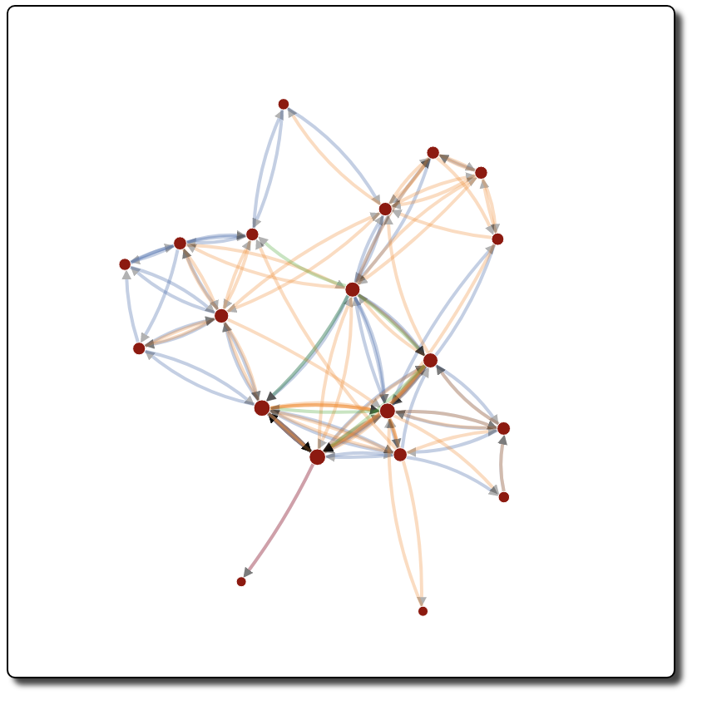
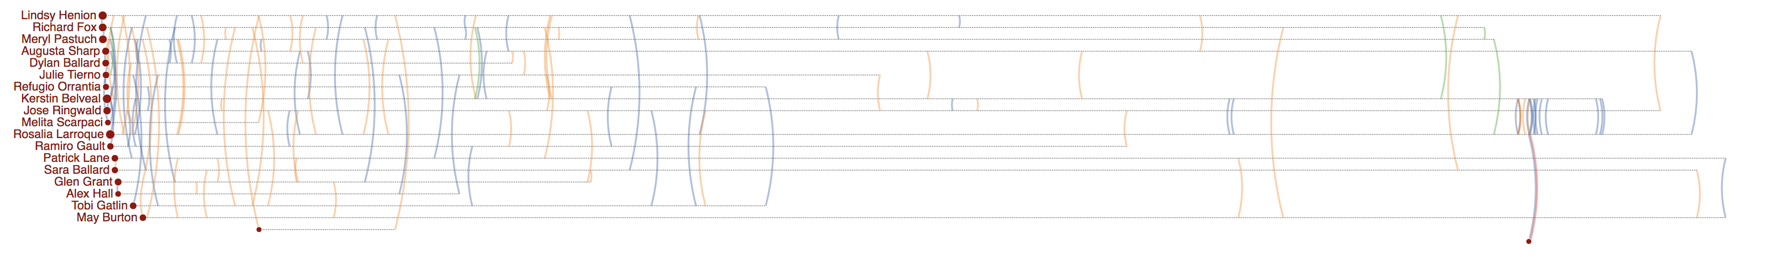
Rosalia Larroque
Rosalia Larroque
Jenice Savaria
Jenice Savaria

Slide 2
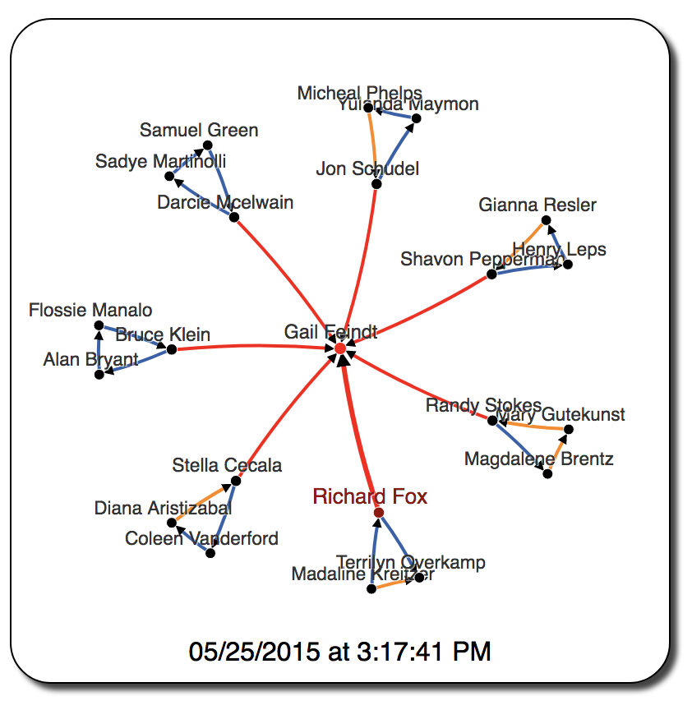
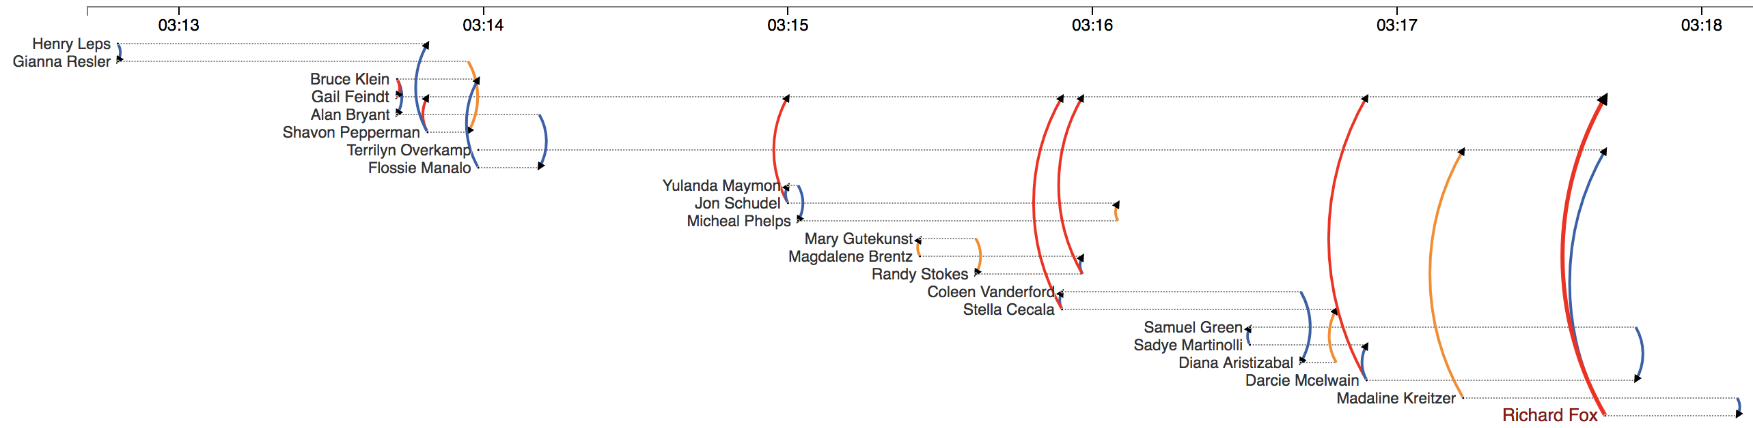

Slide 3
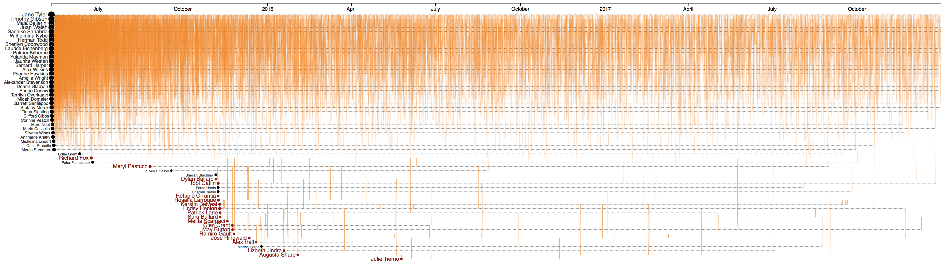
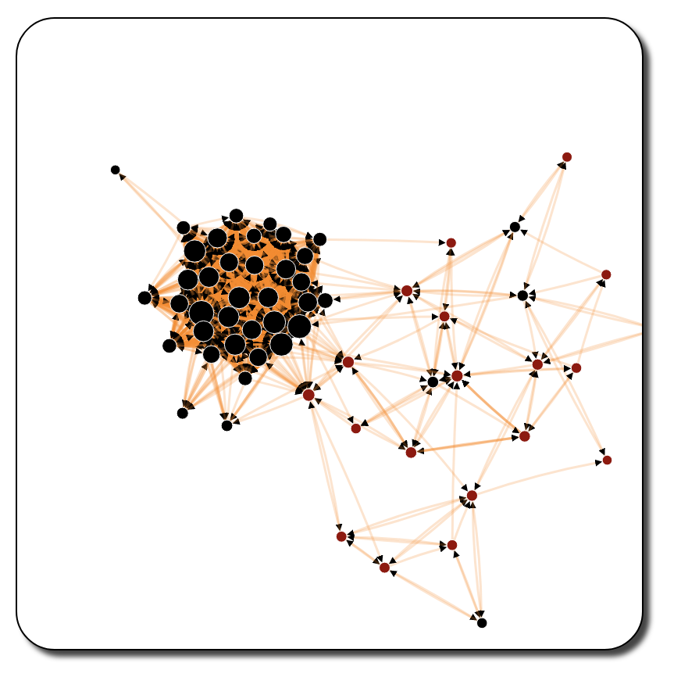
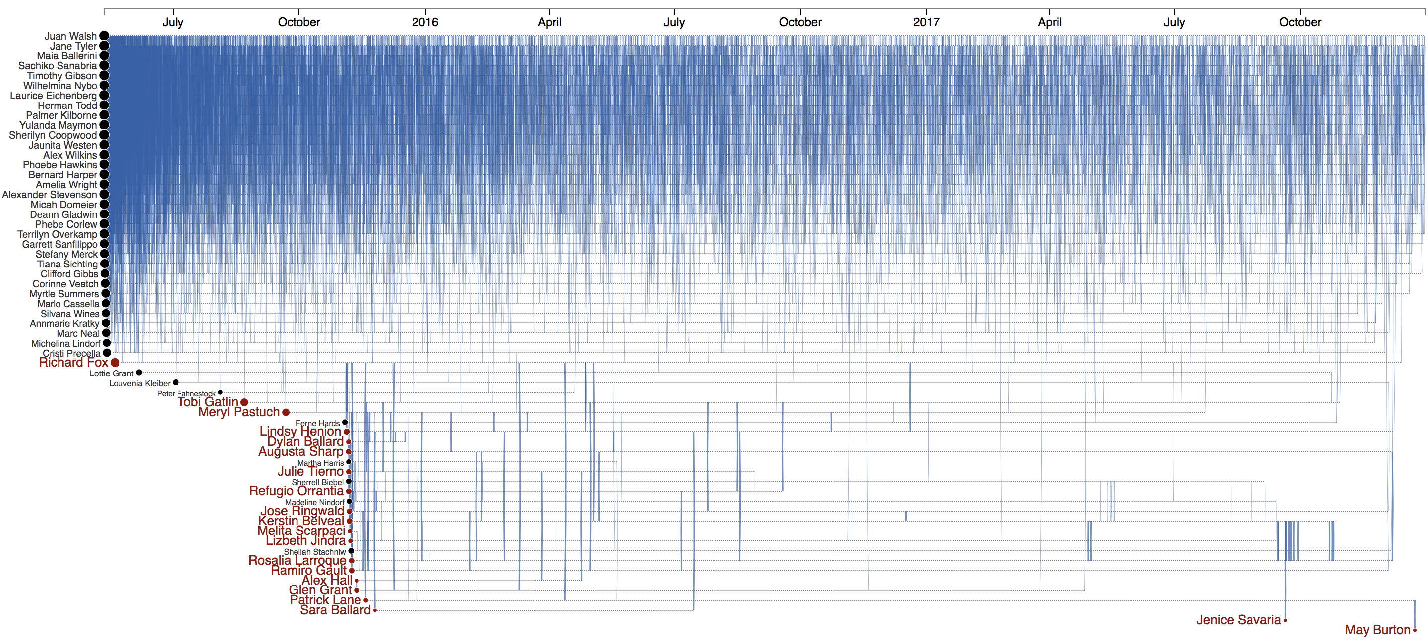
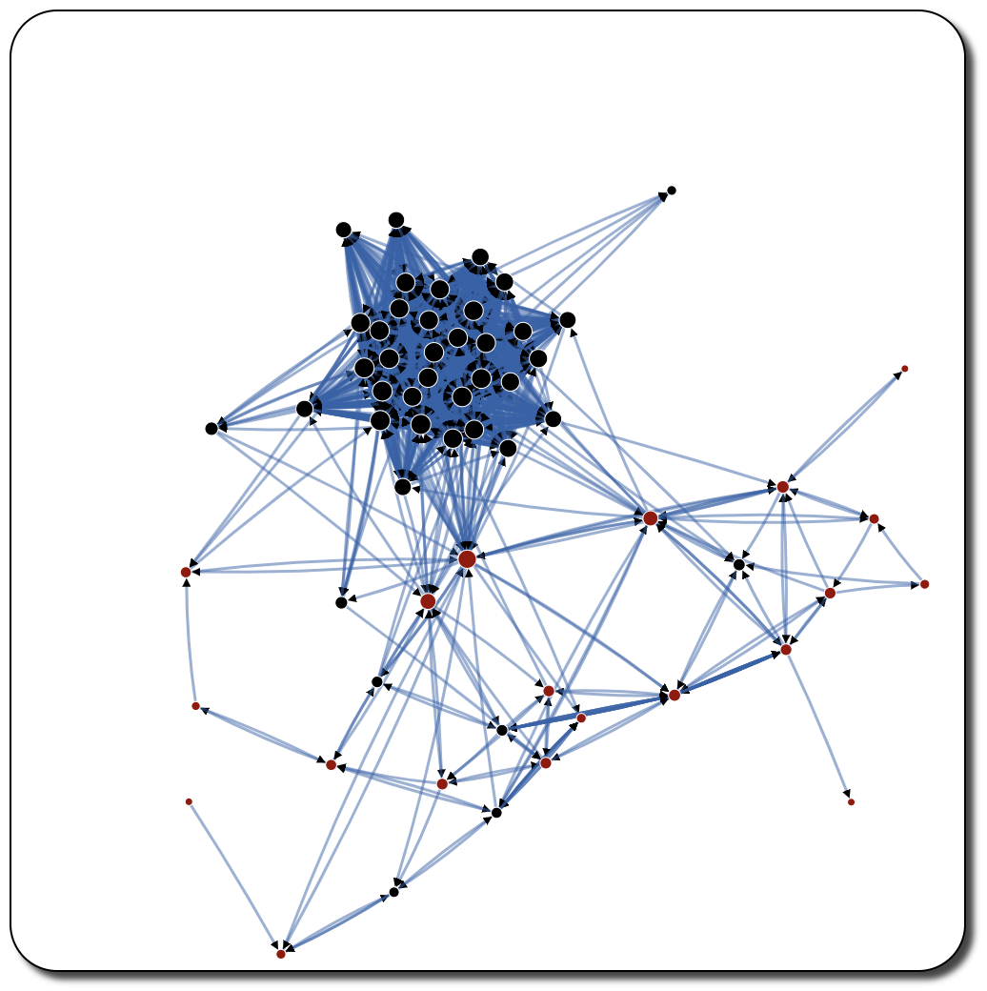

Slide 5
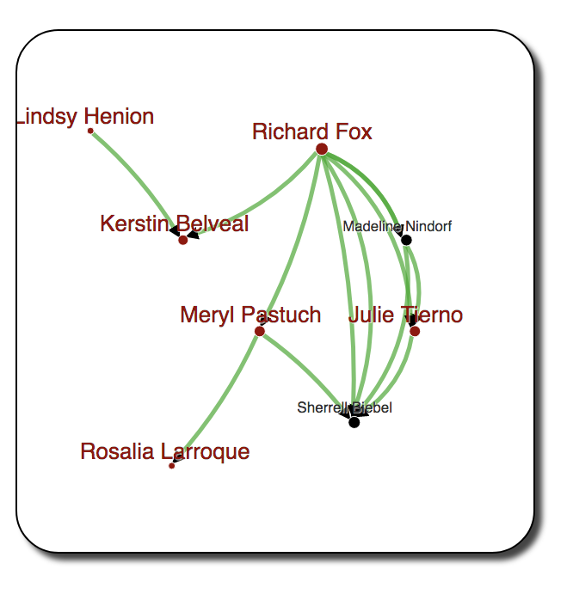
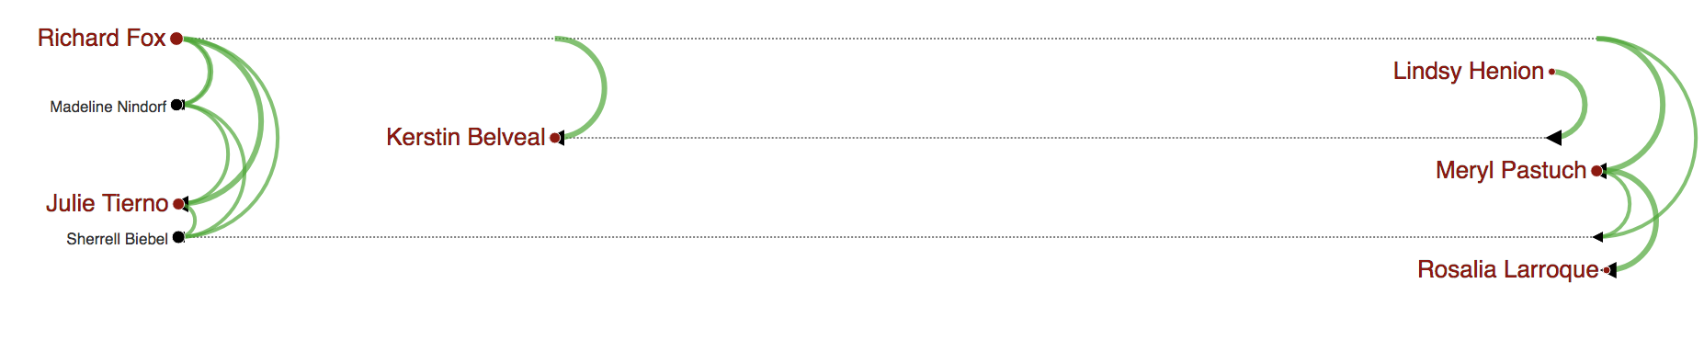
(a)
(b)
Gail Feindt

Slide 6
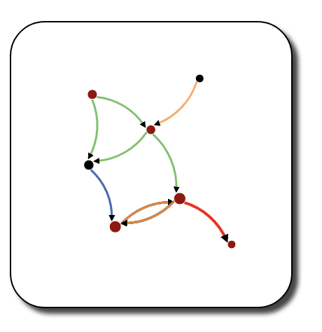
Richard Fox
Peter Fahnestock
Meryl Pastuch
Sherrell Biebel
Rosalia Larroque
Kerstin Belvea
Jenice Savaria
Jenice Savaria
(b)
(a)
Gail Feindt

Slide 7
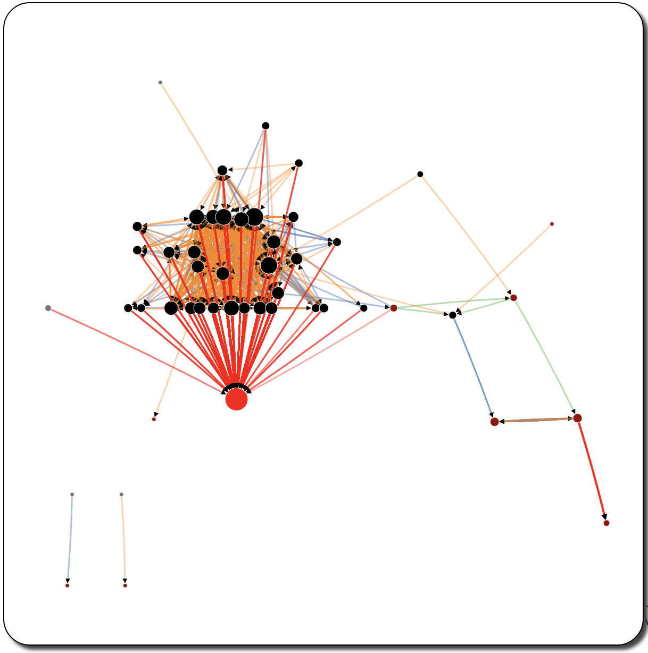
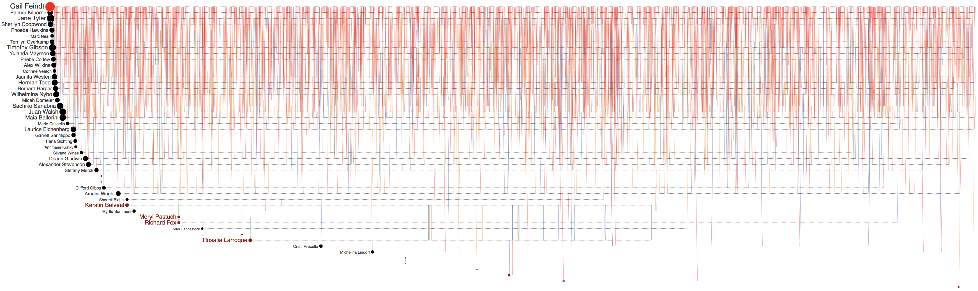
Peter Fahnestock
Meryl Pastuch
Richard Fox
Sherrell Biebel
Kerstin Belvea
Rosalia Larroque
Gail Feindt
Jenice Savaria
Jenice Savaria
Jenice Savaria

Slide 8
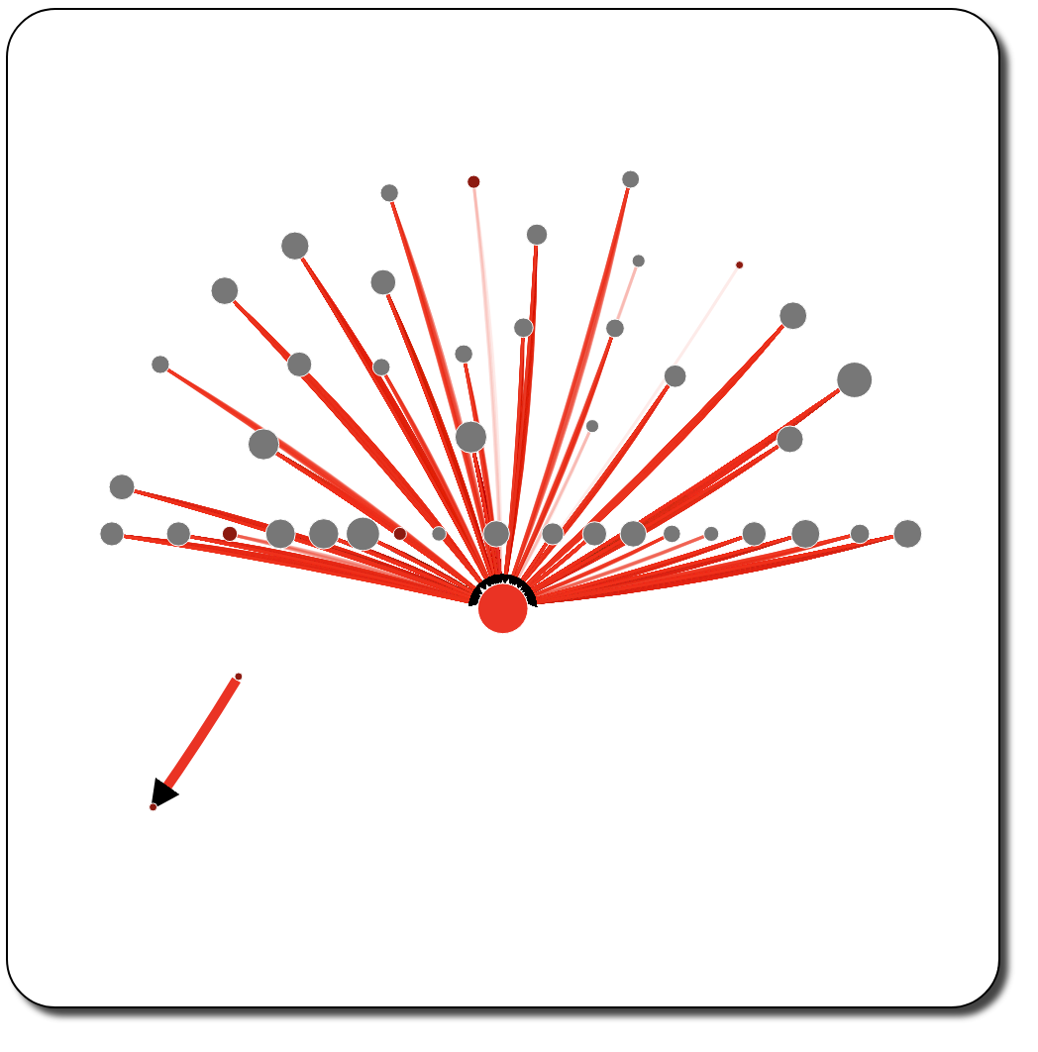
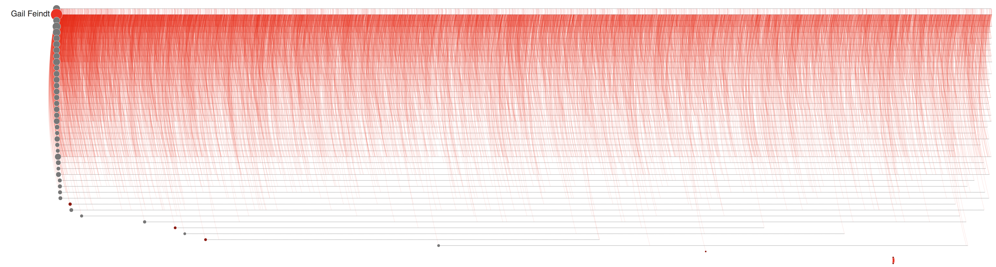


Rosalia Larroque
Jenice Savaria
(a)
(b)
Rosalia Larroque
Jenice Savaria

Slide 9
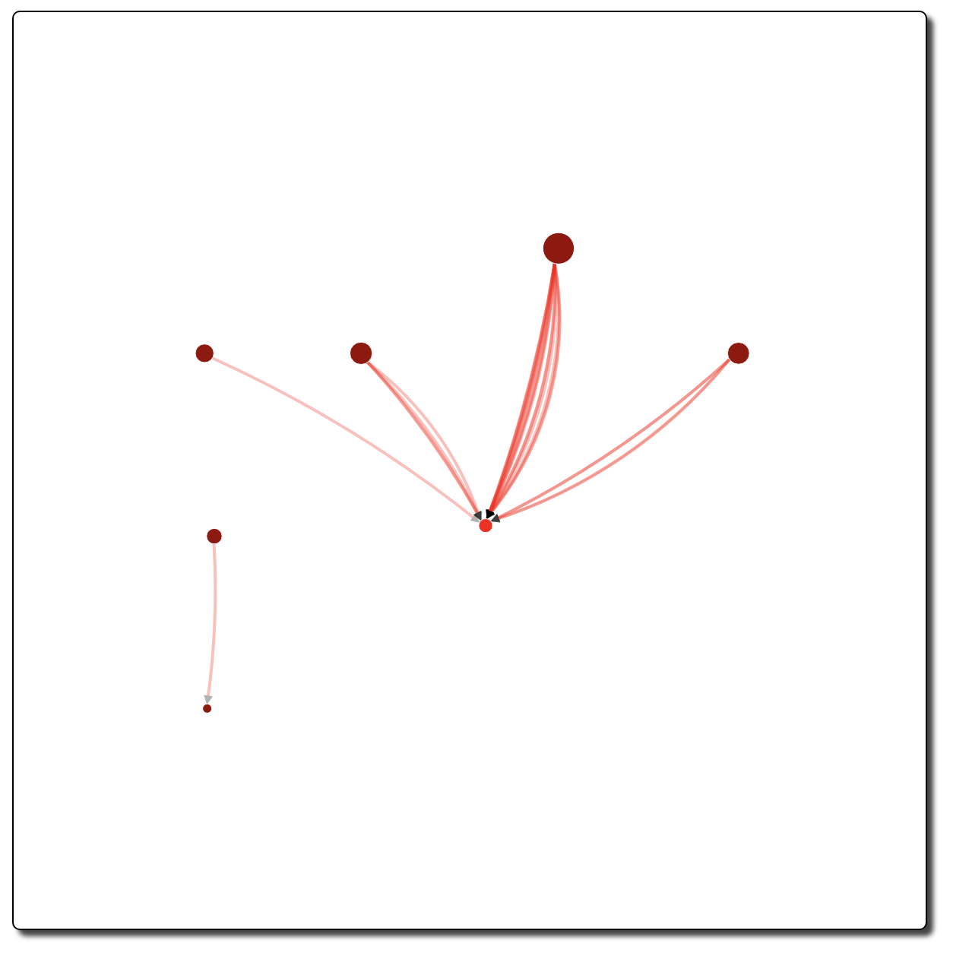
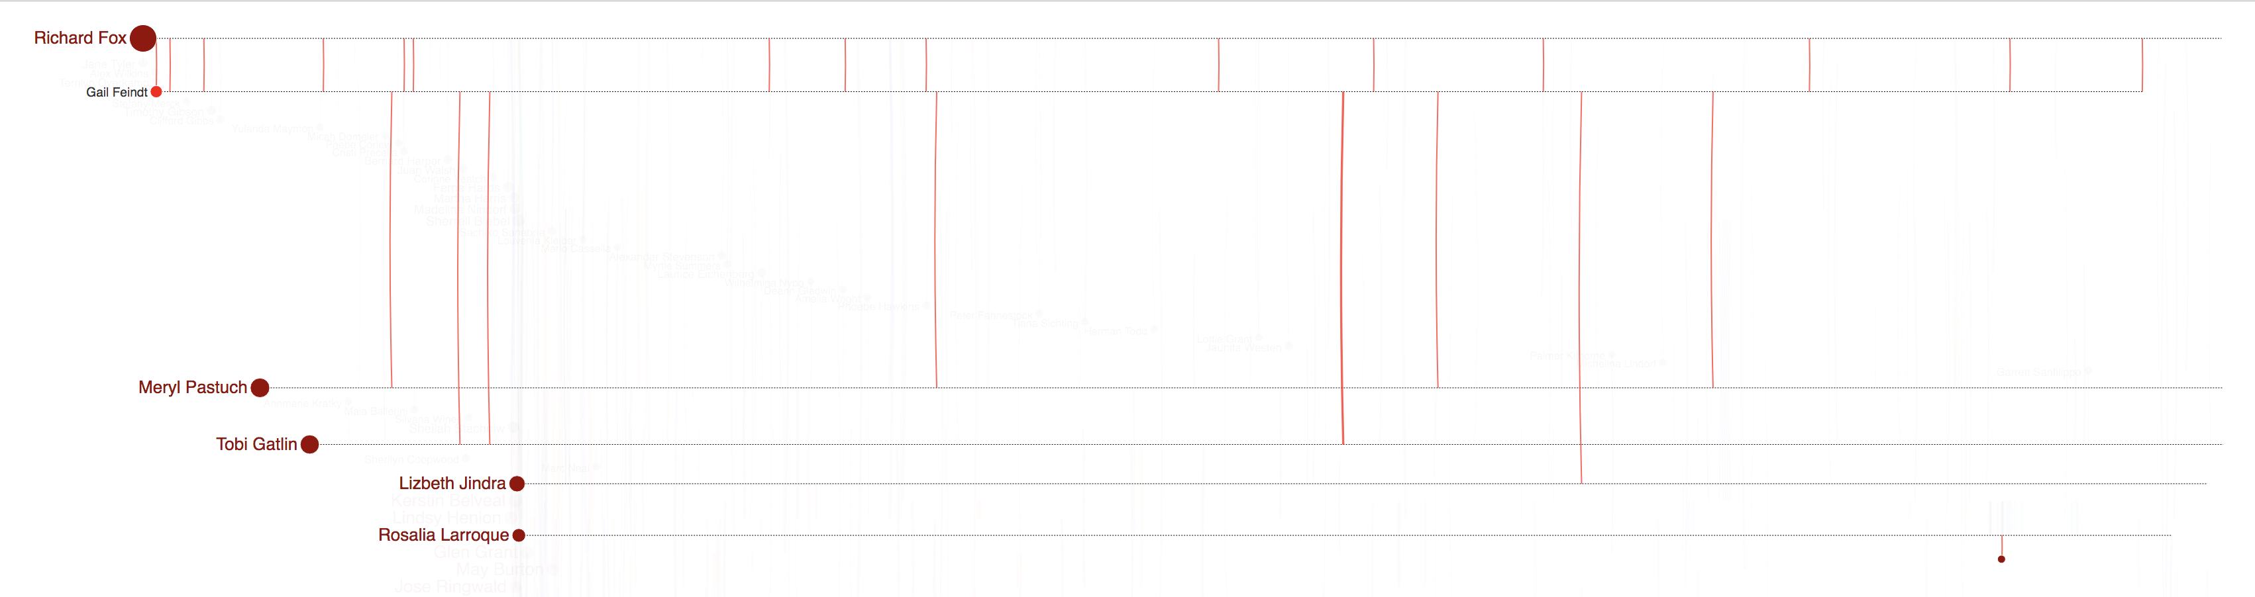
(a)
(b)

Slide 10
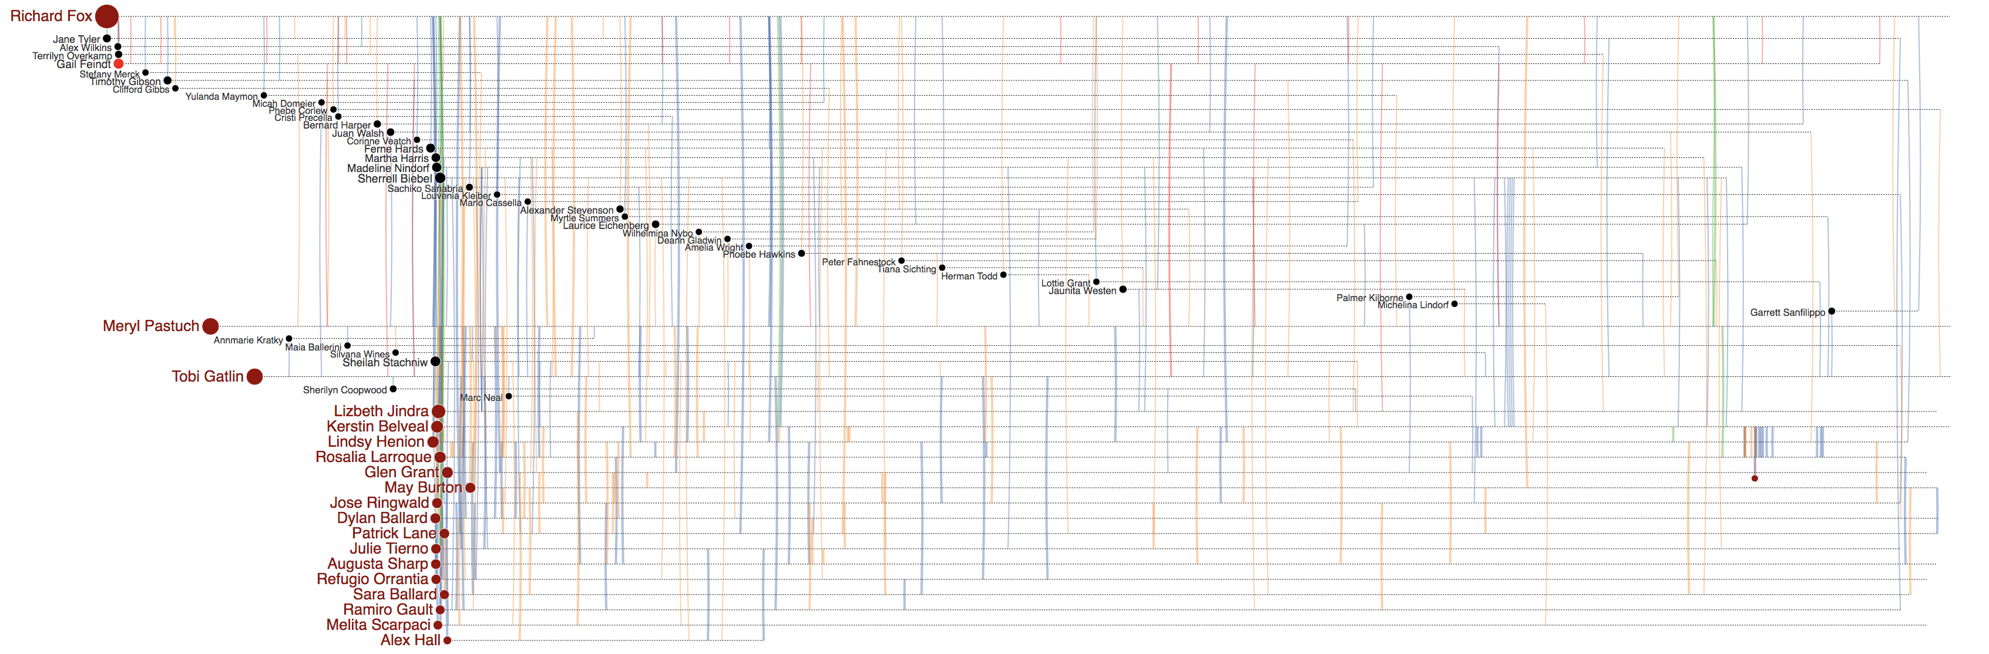
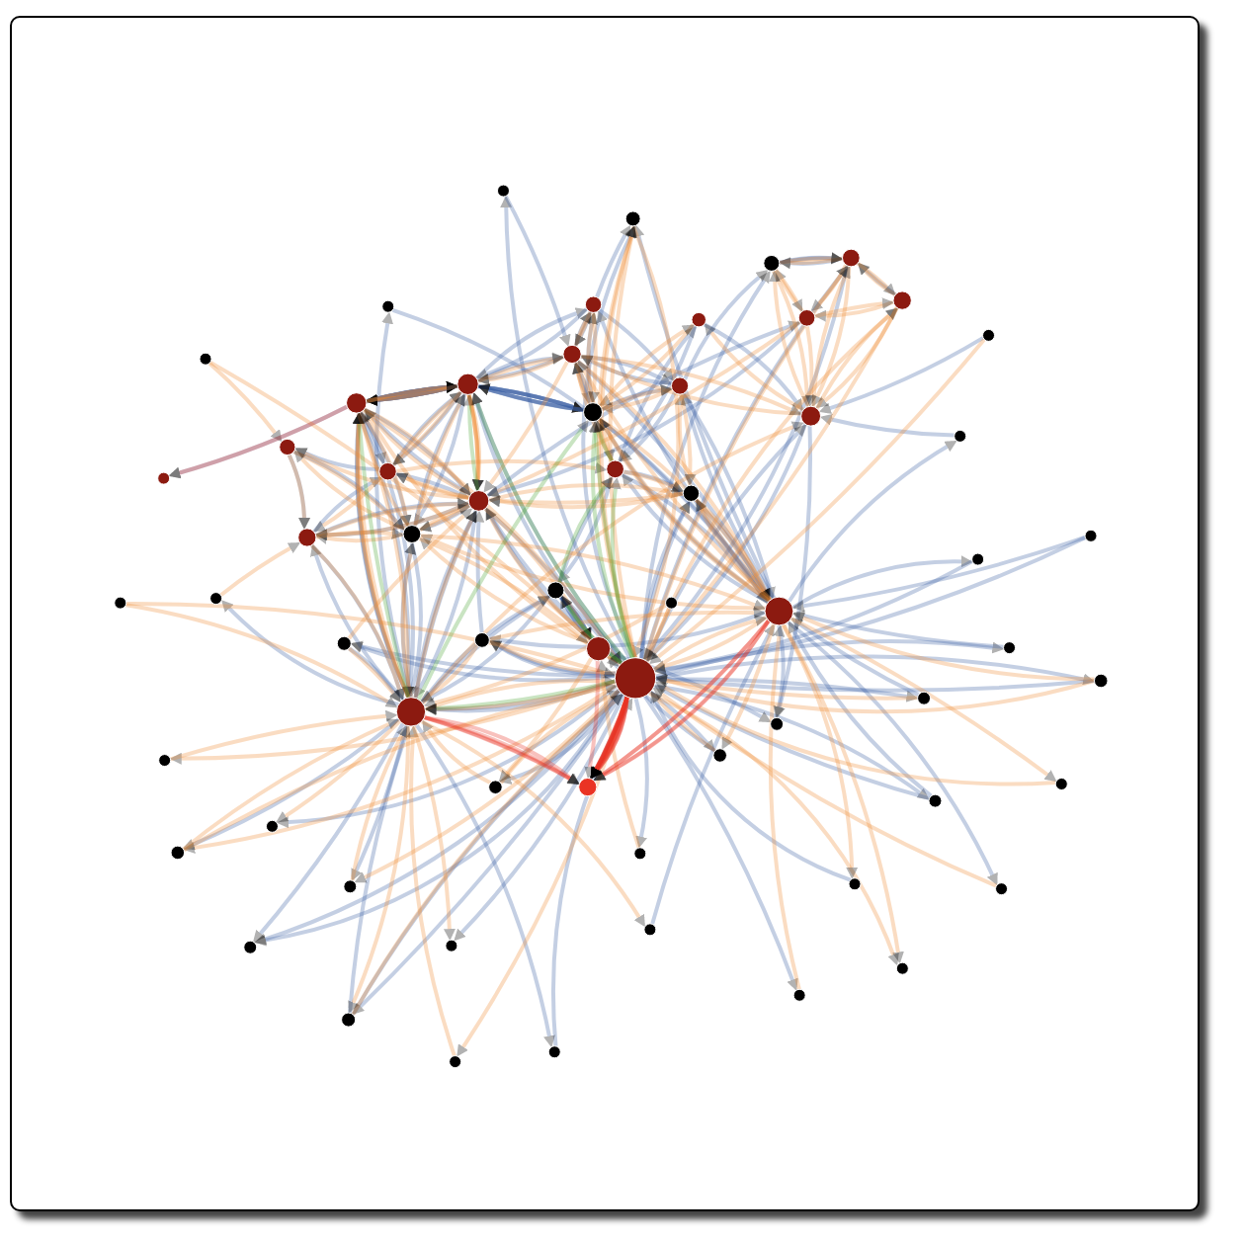
(a)
(b)

Slide 11
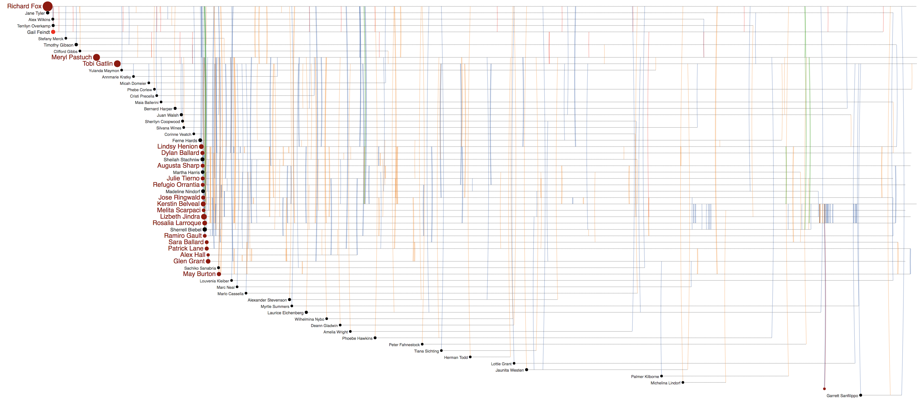
Jenice Savaria
Gail Feindt
(b)
Jenice Savaria
(a)
Jenice Savaria
(c)

Slide 12
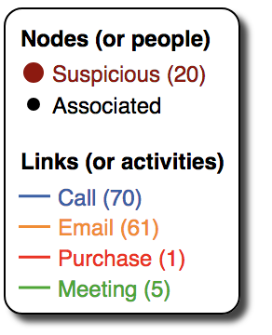
Rosalia Larroque
Rosalia Larroque
Jenice Savaria
(b)
Jenice Savaria
(a)

